Slide 1

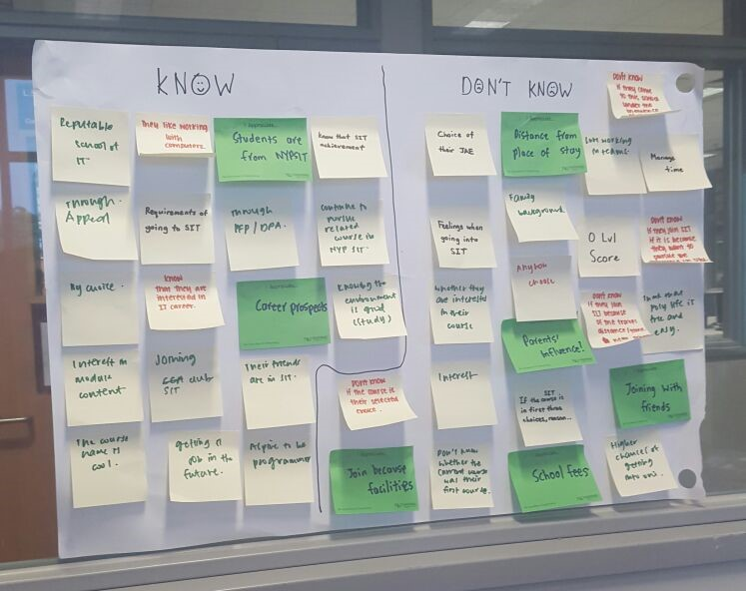
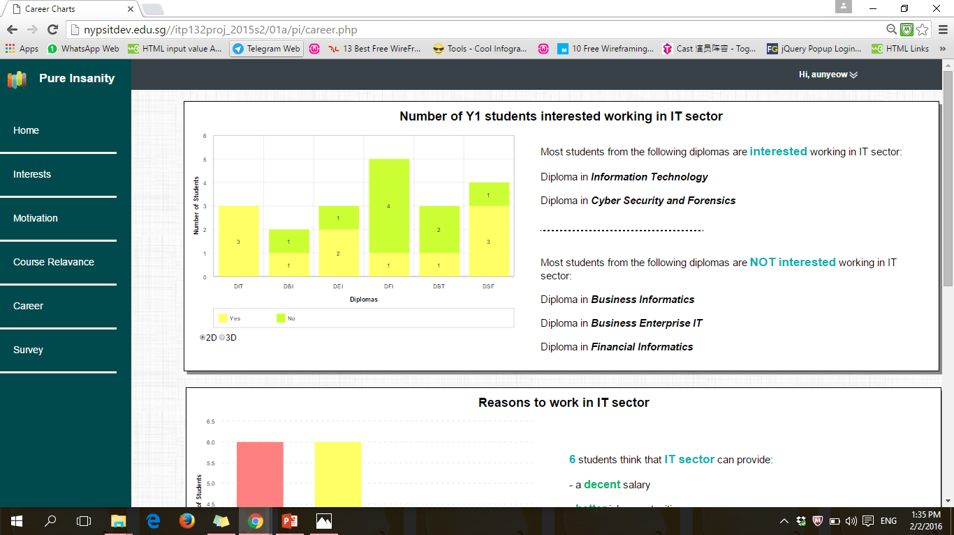
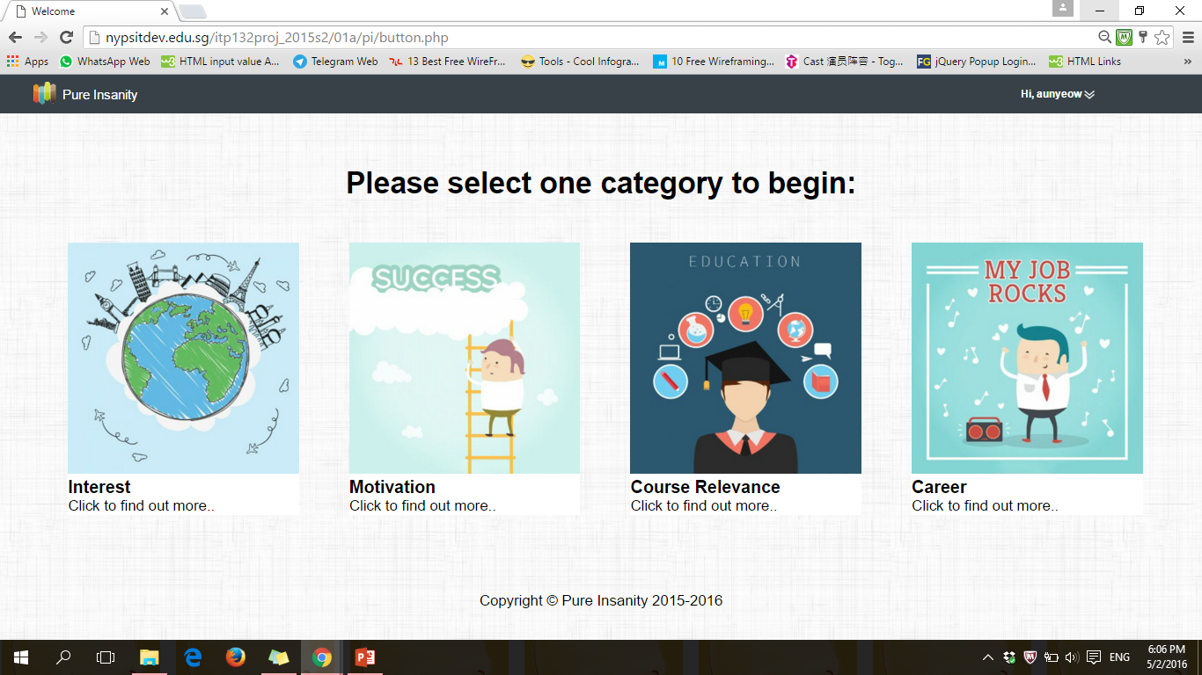

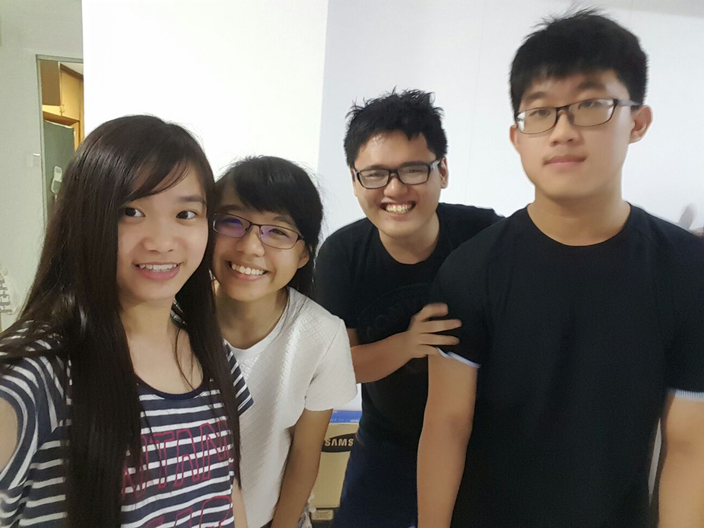
How the ideas are generated?
Pure Insanity
Our group were given a challenge and we are supposed to find out on why they joined NYPSIT. We generated ideas using this challenge. However, to provide more accuracy and credibility, we conducted survey with a sample size of 20 students. Using the survey results, we had our re-define challenge. Re-define challenge allowed us to brainstorm on ideas that will allowed us to come up with an application that will be suitable and relevant to the users. Thus, we generated ideas on how we should present our data to the users and my group decided to present our data using different types of interactive charts. Also, we have divided the survey results into 4 different category, which each category are made of 2 charts.
The Idea
We decided that users can login using different types of platform such as normal login and social login that comprises of Facebook and Google login. After the users had successfully login, they will come into the home page of our application, where they can choose one of the category to begin with. After a user had choose the category they wanted, they will be able to see the interactive graph that we have generated from our excel documents. To provide convenience to the users, they are able to hover the charts and see the details of the charts.
The Team: Aw Aun Yeow (152899E)
Tan Jun Long (151176T)
Chong Yan Qing (154466H)
Done by: Gan Wan Tian Mabel (151477X)

